Slide 1

welcome

Slide 2
Title- Hotel Cleaning Application. Aim- Our Aim Is To Create Order And Reduce Loss Of Time For Housekeepers And To Ensure Business Objectives Are Met. Objectives- 1] The Android App Is To Have A User Interface Which Is Easy Enough For Staff To Use Without Distractions. 2] The Android App Is To Be Functional To Accurately Report Which Rooms Have Been Cleaned Or Which Need To Be Cleaned. 3] The Windows App Is To Have A User Interface For Management To Easily Assign Cleaners To Rooms That Require Cleaning. 4 ] The Windows App Is To Display The List Of Rooms Available And Which Need Cleaning For Management To See.

Slide 3
SCOPE- To Bring Better Communication Between Staff Members Within The Accommodation Industry, Which Will Essentially Save Them Time.

Slide 4
Project Description- The Issues Faced In Small To Medium Accommodation Industries Are Ensuring The Front Desk Is Aware Of The Rooms Completed And Ensuring Customers Do Not Enter Un-cleaned Rooms. We Have Taken This Opportunity To Create An Android Application For Employees To Be Able To Report Back To The Reception About Which Rooms Have Been Cleaned While Also Allowing The Front Desk To Assign Staff To Specific Rooms That Require Cleaning.

Slide 5
MOV-MEASURABLE ORGANISATIONAL VALUE. The Measurable Organizational Value Of This Project Is Targeting At Operational Impact And Also Customer Impact, Finance. 1] OPERATIONAL IMPACT-It Will Make Communication Easer For The Housekeepers And Front Desk Staff As The Application Will Allow The Housekeepers To Update Front Desk With Rooms They Have Completed And Also The Front Desk Will Be Able To Allocate Work For Each Housekeeper Remotely. 2] CUSTOMER IMPACT-This Will Be More Impacting To The Company As The Accommodation Industry Is Based On Customer Service So If The Guest Has Requested An Early Check In The Front Desk Will Have Real-time Progress Of Rooms Completed And Hence Will Adhere To The Guests Request Therefore Creating A Rapport With The Guest And Ensuring Quality Service And Therefore Fulfilling The Business Objective.

Slide 6
3] FINANCIAL IMPACT-This Is More Impactful To The Business As This Application Will Reduce Time Lost In Housekeepers Coming To Front Desk To Update On The Rooms That They Have Completed And Therefore This Application Will Eliminate This Loss Of Time And Hence Will Stop Money Being Lost In The Process.

Slide 7
EXPECTED FUNCTIONALITIES OF THE PRACTICAL AND PLATFORM(S) USED It’ll Allow Us To Better Iterate ‘Sections’ Of The Project To Tackle, And It’ll Allow Us, As A Team, To Better Adapt With Any New Requirements Or Features That May Come Our Way. The Resources We’ll Be Using Will Be: Android Studio, Visual Studio, Office 365, A Database, And A Mobile Phone And Computer For Development And Testing.

Slide 8
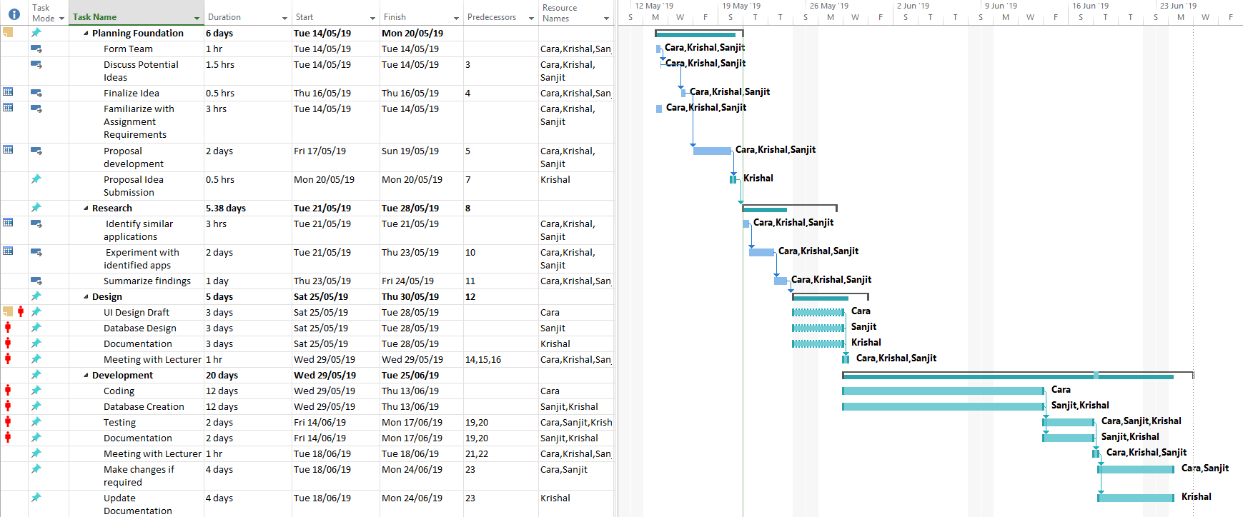
GANTT CHART

Slide 9

WHO WILL DO WHAT Cara: App Design Draft Use Case/Flow Diagram App Development Sanjit: Power Point Database Krish: Submissions Database Shared: Proof Reading Team Meetings Lit Review/Research

Slide 10
Thank you No question please

